Slide 1
C.3 Nuclear fusion and fission

Slide 2
Within the nucleus there are two forces at play:
electrostatic forces of repulsion between protons
strong nuclear forces of attraction between nucleons (protons and neutrons)
[a very short distance force, but 100x stronger than electrostatic force]

Slide 3
Nuclear energy: energy that is released when atomic nuclei change.
There are two ways this can occur:
i. Nuclear fusion: when two very light nuclei (such as hydrogen) combine.
example:
These are the reactions that fuel the stars!

Slide 4
ii. Nuclear fission: when a very heavy nucleus (such as uranium) splits into smaller sized nuclei.
example:
These are the reactions that fuel nuclear power plants…
and atomic bombs.

Slide 5
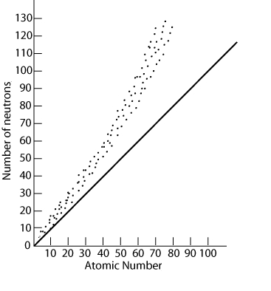
As the nucleus of atoms increase, more neutrons are needed to help overcome the proton-proton forces of repulsion.
“the band of stability”

Slide 6
During both nuclear fission or fusion, mass is lost and converted to pure energy,
as represented by Einstein’s
equation:
E = mc²
energy
the speed of light
mass

Slide 7
The most stable nuclei (where the opposing forces balance) are those of iron and nickel.
These are said to have the maximum “binding energy.”
Binding energy represents the amount of energy released in a fission or fusion reaction.

Slide 8
Mass defect: the difference between the mass of a nucleus and the sum of the masses of its nucleons.
mass defect =
(mass of nucleus) - (mass of nucleons)

Slide 9
That is, the mass defect is the mass that has been converted to pure energy:
E
m
=
c²

Slide 10
Radioactivity
Unstable nuclei (radioisotopes) will spontaneously give off high energy particles and radiation:
alpha particles (α): helium nuclei
beta particles (β): fast-moving electrons
gamma rays (γ): high-energy radiation
All cause ionization as they travel though material, gamma rays most of all.

Slide 11
The health risks of radiation depend on the source and/or the duration of exposure.
Low doses have virtually no effect, such as radioactive rocks or cosmic rays.
Larger doses will produce ions and free radicals which can do great damage to living tissue - e.g. cancer.

Slide 12
Activity: the number of radioactive particles given out each second.
Half-life (t1/2): the time it takes for half the amount of a radioactive material to decay.

Slide 13
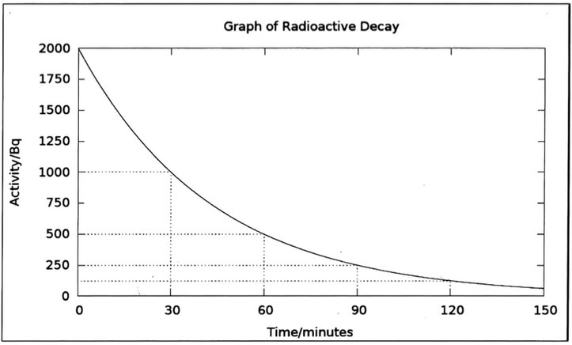

Slide 14
Half-life equations:
t1/2 = ln2 / λ
where λ is called the decay constant.
N = Noe^{-λt}
where No is the original amount and N the amount remaining after time t.

Slide 15
Practice:
a. Calculate the half-life of iodine-131 if it is found that only 1/32 of its original amount remains after 40.3 days.
b. If the original mass was 0.0024 grams, what mass remains after 7.0 days?

Slide 16
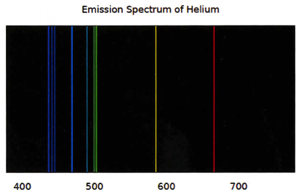
Spectroscopy
Emission spectra:
The light emitted by an excited element.

Slide 17
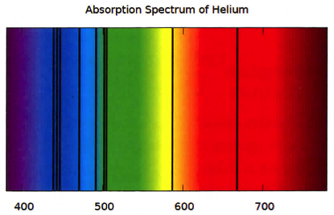
Absorption spectra:
Dark lines in an otherwise continuous spectrum produced when light passes through a gas.
Used to identify elements within stars.

