Slide 1
Math Practice

Slide 2
Showing Math Work Essentials:
1. All numbers must include a unit.
2. Do not use a dot for multiplication, use: X
3. For numbers less than 1, a zero must precede the decimal point.
4. Calculations must include operation symbols (x, /, +, -, = , etc.).
5. Combine or cancel units as if they were algebraic variables.
6. Box final answers.

Slide 3
Significant Figures (“sig figs”):
The number of all known digits reported in a measurement, plus one estimated digit.

Slide 4
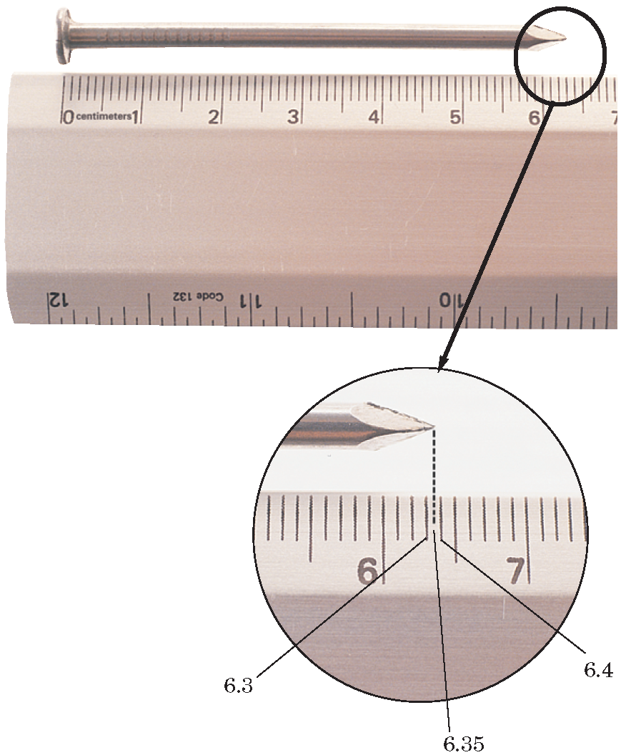
What should be the reported length of this nail?
6.35 cm
estimated

Slide 5
Rules for determining the
number of sig figs in a measurement
Tutorial

Slide 7
Sample Problem
How many significant figures are in each of the following measurements?
a. 28.6 g
b. 3440. cm
c. 910 m
d. 0.046 04 L
e. 0.006 700 kg

Slide 8
Solution
a. 28.6 g
There are no zeros, so all digits are significant. Answer: 3 sig figs
b. 3440. cm
The zero is significant because it is followed by a decimal point. Answer: 4 sig figs
c. 910 m
The zero is not significant, it is only a place holder. Answer: 2 sig figs

Slide 9
d. 0.04604 L
The first two zeros are not significant; the third zero is significant. Answer: 4 sig figs
e. 0.006700 kg
The first three zeros are not significant; the last two zeros are significant. Answer: 4 sig figs

Slide 10
Rules for rounding
Tutorial

Slide 11
Rounding practice:
Round to 3 sig figs:
427.6 → 428
427.4 → 427
427.5 → 428 (odd/even rule)
426.5 → 426 (odd/even rule)
426.51 → 427

Slide 12
Rules for calculations
1. Addition or Subtraction:
Round answer to have same number of decimal places as the number having the fewest decimal places.
2. Multiplying and dividing:
Round answer to have the same number of sig figs as the number with the least sig figs.

Slide 13
Sample Problem E
Solve with correct number of significant figures and units.
a. 5.44 m - 2.6103 m
b. 2.4 g/mL × 15.82 mL

Slide 14
Solution
a. 5.44 m - 2.6103 m = 2.84 m
There should be two digits to the right of the decimal point, to match 5.44 m.
b. 2.4 g/mL × 15.82 mL = 38 g
There should be two significant figures in the answer, to match 2.4 g/mL.

