Slide 1
Ch 12 p294-296
Emission spectra
and ionization energy

Slide 2
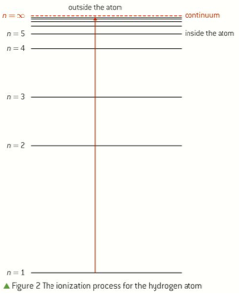
Ch 12 p295
Limit of convergence:
The distance from the nucleus where the energy levels converge, called a continuum.

Slide 3
Beyond the continuum an electron is no longer under the influence of the nucleus - i.e., ionization has occured.
The radiation in the emission spectrum at the limit of convergence can be used to determine the first ionization energy for a hydrogen atom (IE1).

Slide 4
= 1st ionization energy (IE1)

Slide 5
The energy needed to ionize a hydrogen atom is related to the highest energy emission line found in the Lyman series (UV region),
when an electron falls from n= ∞ to n=1.

Slide 6
Practice:
a. Calculate the first ionization energy, in kJ/mol, for hydrogen given its shortest wavelength line in the Lyman series is 91.16 nm.
b. What is the frequency of this radiation in hertz (Hz)?

