Slide 1
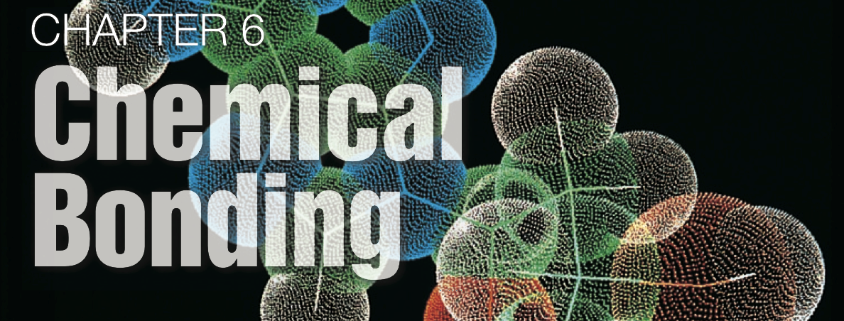
Unit 4: Ionic Bonding

Slide 2
Section 7.1
(Pages 207-215)
Chemical Formulas
for Ionic Compounds

Slide 3
Important terms:
Ionic compound:
A pure substance composed of positive and negative ions combined to give a net charge = 0.
Formula unit:
the simplest whole number ratio of ions in an ionic compound.

Slide 6
Types of ions:
1.) monatomic ions (a single atom).
2.) polyatomic ions (contains 2 or more atoms.)
Note: many polyatomic ions are "oxyanions" (containing oxygen).
[See the back of your periodic table]

Slide 7
Writing formulas for ionic compounds...
Two simple rules:
1.) Write the cation first
2.) Combine ions such that the sum of their charges = 0
[Note: compounds have no charge!]

Slide 8
Writing formulas for ionic compounds...
Two simple rules:
1.) Write the cation first
2.) Combine ions such that the sum of their charges = 0
[Note: compounds have no charge!]

Slide 9
Chemical Formulas indicate the number of atoms in a compound.
Examples:
Formula | Number of each atom
NaCl | 1 Na, 1 Cl
MgCl2 | 1 Mg, 2 Cl
Al2O3 | 2 Al, 3 O
Na3PO4 | 3 Na, 1 P, 4 O
Ca(OH)2 | 1 Ca, 2 O, 2 H
Al2(SO4)3 | 2 Al, 3 S, 12 O

Slide 10
Naming ionic compounds
1. Binary ionic compounds
(only two elements):
metal (cation) + nonmetal (anion)
To name compound:
name metal +
name nonmetal
(adding the suffix “ide”)

Slide 11
Examples:
Formula | Name
NaCl | sodium chloride
MgCl2 | magnesium chloride
Al2O3 | aluminum oxide
Na3N | sodium nitride
CaO | calcium oxide
K2S | potassium sulfide

Slide 12
2. Ionic compounds containing a polyatomic ion:
(only two elements):
To name compound:
name metal +
name polyatomic ion

Slide 13
Examples:
Formula | Name
Na3PO4 | sodium phoshate
Ca(OH)2
Al2(SO4)3
NH4NO3
NH4HSO4

Slide 14
Examples:
Formula | Name
Na3PO4 | sodium phoshate
Ca(OH)2 | calcium hydroxide
Al2(SO4)3 | aluminum sulfate
NH4NO3 | ammonium nitrate
NH4HSO4 | ammonium bisulfate

Slide 15
3. Ionic compounds containing metals with two possible charges:
(only two elements):
Examples:
Formula | traditional name | stock name
FeCl2 | ferrous chloride | iron(II) chloride
FeCl3 | ferric chloride | iron(III) chloride
PbS | plumbous sulfide | lead(II) sulfide
PbS2 | plumbic sulfide | lead(IV) sulfide

