Slide 1
Periodic Trends: Physical & Chemical Properties

Slide 2
Melting Points
Alkali metals: metals are held together by metallic bonds.

Slide 4
Melting Points
1.) Alkali metals: metals are held together by metallic bonds.
The larger the atom, the weaker the bond and therefore…
the lower the melting point.
Li
Melting point
decreases
Cs

Slide 5
2.) Halogens: held together by very weak dispersion forces.

Slide 6
2.) Halogens: held together by very weak dispersion forces.
The smaller the molecule, the weaker the force of attraction…
and therefore the
lower the melting point.
F
Melting point
decreases
I

Slide 7
Chemical
Properties

Slide 8
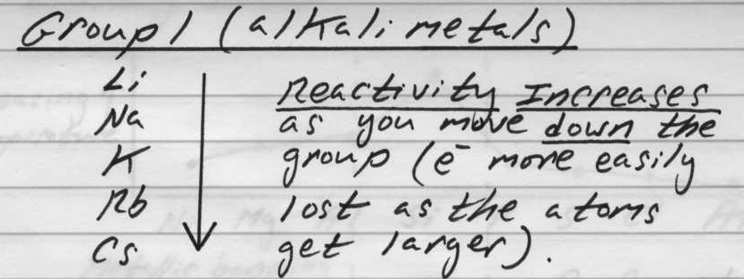

Slide 9
Alkali metal reactivity with water:
2
X(s) + H2O(l) —>
2
H2(g) + XOH(aq)
2
X: any alkali metal
a basic solution

Slide 10
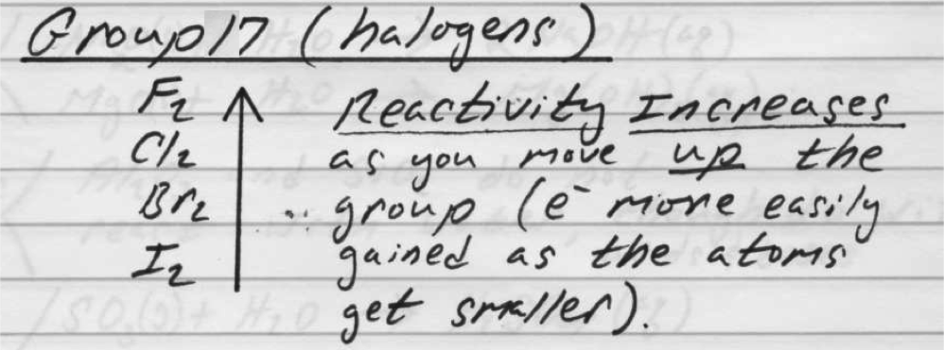
The more reactive halogen is a stronger “oxidizing agent.”

Slide 11
Best example: Single replacement reactions
Cl2(g) + NaF(aq) —>
No rxn
2
Br2(l) + NaCl(aq)
Cl2(g) + NaBr(aq) —>
2
(solution turns brown/orange, the color of bromine)

