Slide 1
4.2 Covalent bonding

Slide 2
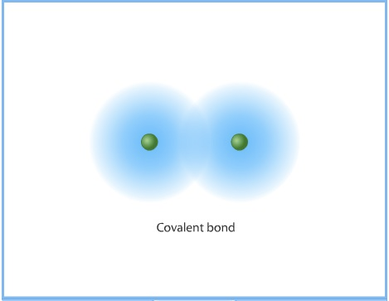
Covalent bond:
the electrostatic attraction between a pair of electrons and positively charged nuclei.
the sharing of electrons between atoms.

Slide 3
General Rule:
Covalent if a nonmetal + nonmetal
To determine covalent bond type, use electronegativity values:
Electronegativity Difference | Bond type
< 0.3 | nonpolar covalent
0.3 - 1.7 | polar covalent
>1.7 | ionic

Slide 4
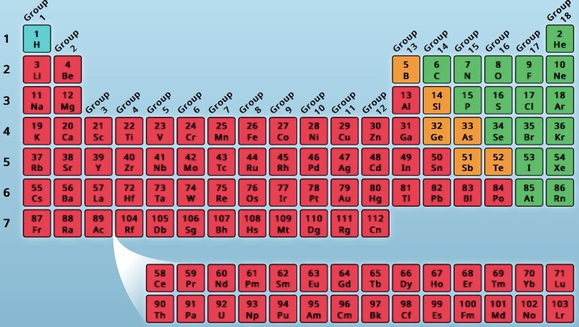
Online Tutorial

Slide 5
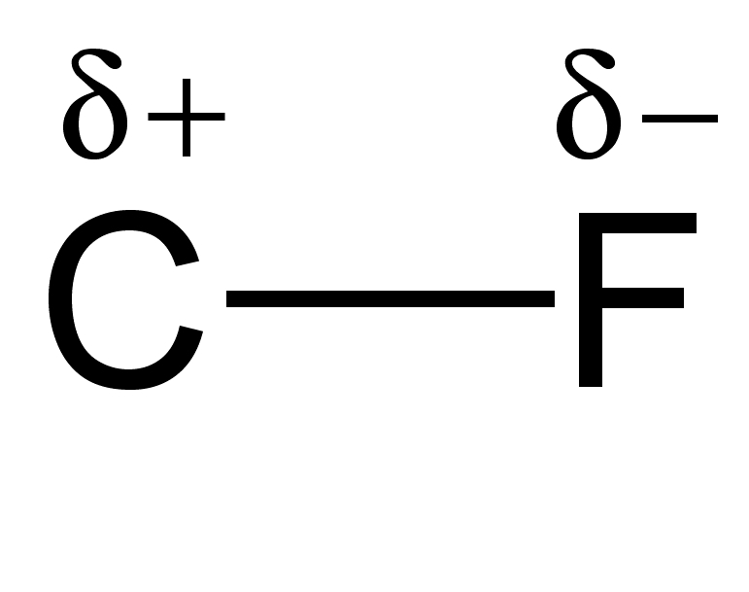
The Greek letter delta (δ)
to represent polarity.
…or an arrow!

Slide 6
Naming
Use prefixes to name binary molecular compounds:
1 | mono |  | 6 | hexa
2 | di |  | 7 | hepta
3 | tri |  | 8 | octa
4 | tetra |  | 9 | nona
5 | penta |  | 10 | deca

Slide 7
Lewis structures:
The use of dots and dashes to represent the valence electrons of an atom, ion, or molecule.

Slide 8
Steps for drawing Lewis structures for molecules or polyatomic ions:
Total all valence electrons (and charges).
Connect all atoms to a central atom.
Add dots to complete an octet around every atom connected to a central atom (except hydrogen).
Add dots to complete the central atom’s octet.
If too few electrons are available, use multiple bonds.

Slide 9
The HONC Rule

Slide 10
Exceptions to the octet rule:
1. Hydrogen will have only 1 pair of electrons surrounding it.
2. Boron will only have 3 pairs of electrons surrounding it.
3. Beryllium (a metal) can form covalent bonds with only have 2 pairs of electrons surrounding it.

Slide 11
4. Sulfur and Phosphorus will occasionally have more than 4 pairs of electrons by using their empty d-orbitals.
This is called an “expanded octet.”

Slide 12
Special note regarding oxyacids:
(H bonded to an oxyanion)
Hydrogen will ALWAYS be bonded to the oxygen atom(s).

Slide 13
Special note regarding carbon:
Carbon rarely has an unshared pair of electrons.
Two exceptions:
CO
carbon monoxide
CN⁻
cyanide

Slide 14
Is your Lewis structure correct?
Two simple questions to ask:
1.) Did you use the exact number of valence electrons available?
2.) Are all atoms (except hydrogen) surrounded by 8 electrons?

