Slide 1
Properties of Ionic Compounds (6.3)

Slide 2
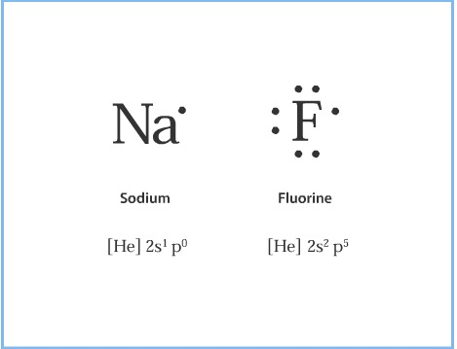
Lewis dot structures: the use of dots to represent an atom’s valence electrons.

Slide 3
Lewis dot structures can be used to show the formation of ionic bonds:
[done on board in class]

Slide 4
Crystal Lattice

Slide 5
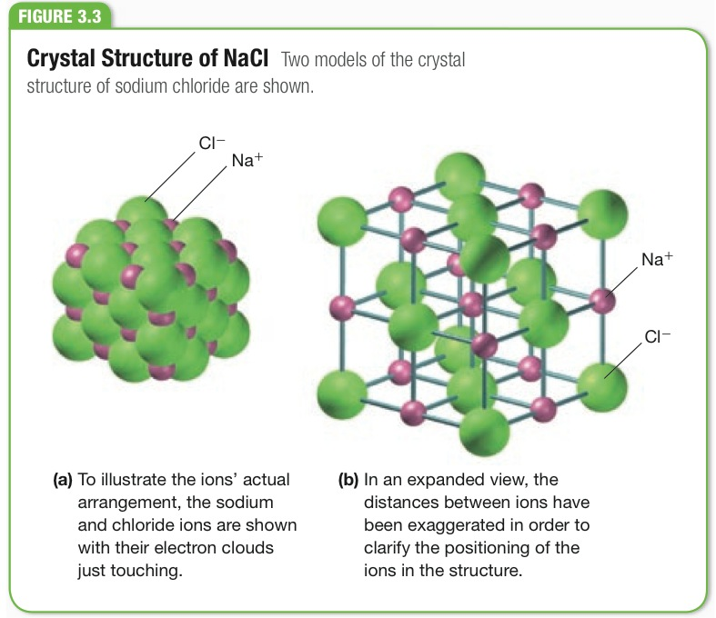
Page 181

Slide 6
Ionic compounds form a tightly
packed "crystal lattice."
Crystal: solids that have a repeating arrangement of atoms, ions, or molecules.
Lattice: structures having a regular geometrical arrangement.

Slide 7
The strength of ionic bonds are:
Directly proportional to the charge of the ions.
Inversely proportional to the size of the ions.

Slide 8
In each set below, which would have the highest melting point?
a. LiF or LiBr
b. CaCl2 or CuCl2
c. CaS or Fe2O3

Slide 12
Properties of Ionic Compounds:
High melting & boiling points
An electrolyte (conducts electricity when molten or dissolved in water)
Hard & brittle

