Slide 1
Topic 20.1
Types of organic reactions (HL)

Slide 2
Nucleophilic substitution reactions

Slide 3
Nucleophile:
An atom or molecule attracted to the nucleus of an atom; contains an unshared (non-bonded) pair of electrons.
Common nucleophiles:
NH3
H2O
OH⁻
CN⁻

Slide 4
Unimolecular:
An elementary reaction with only one reactant.
Bimolecular:
An elementary reaction with two reactants.

Slide 5
SN2 Reactions
(bimolecular nucleophilic substitution)
Occurs in: primary halogenoalkane
(in warm, dilute NaOH)
rate =
k[halogenoalkane][nucleophile]

Slide 7
Example:

Slide 8
SN1 Reactions
(unimolecular nucleophilic substitution)
Occurs in: tertiary halogenoalkane
(in warm, dilute NaOH)
rate = k [halogenoalkane]

Slide 10
Example:

Slide 11
Choice of solvent:
SN1 is favored in polar, protic solvents* such as water or ethanol.
*contains a hydrogen atom bound to an oxygen (as in a hydroxyl group) or a nitrogen (as in an amine group).
SN2 is favored in less polar, aprotic solvents such as an ester or ketone.

Slide 12
Factors affecting rates for
SN1 or SN2 Reactions:
1. Nature of the nucleophile
NH3
H2O
OH⁻
CN⁻
molecule
anion
Electron density
increases
Rate increases

Slide 13
2. Bond Enthalpy
Rate increases
as bond strength decreases.

Slide 14
3. Classification of Carbon
Stability increases
(i.e., lower energy state)
primary
secondary
tertiary
Rate increases

Slide 15
Electrophilic addition reactions
Electrophile:
An electron-deficient species that can accept electron pairs from a nucleophile;
a Lewis acid.

Slide 16
Electrophilic addition of hydrogen halides
δ+
δ-

Slide 17
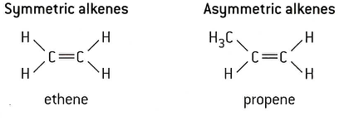

Slide 18
Markovnikov’s rule:
For asymmetrical alkenes, hydrogen will add to the carbon that already contains the most hydrogen atoms.

Slide 19
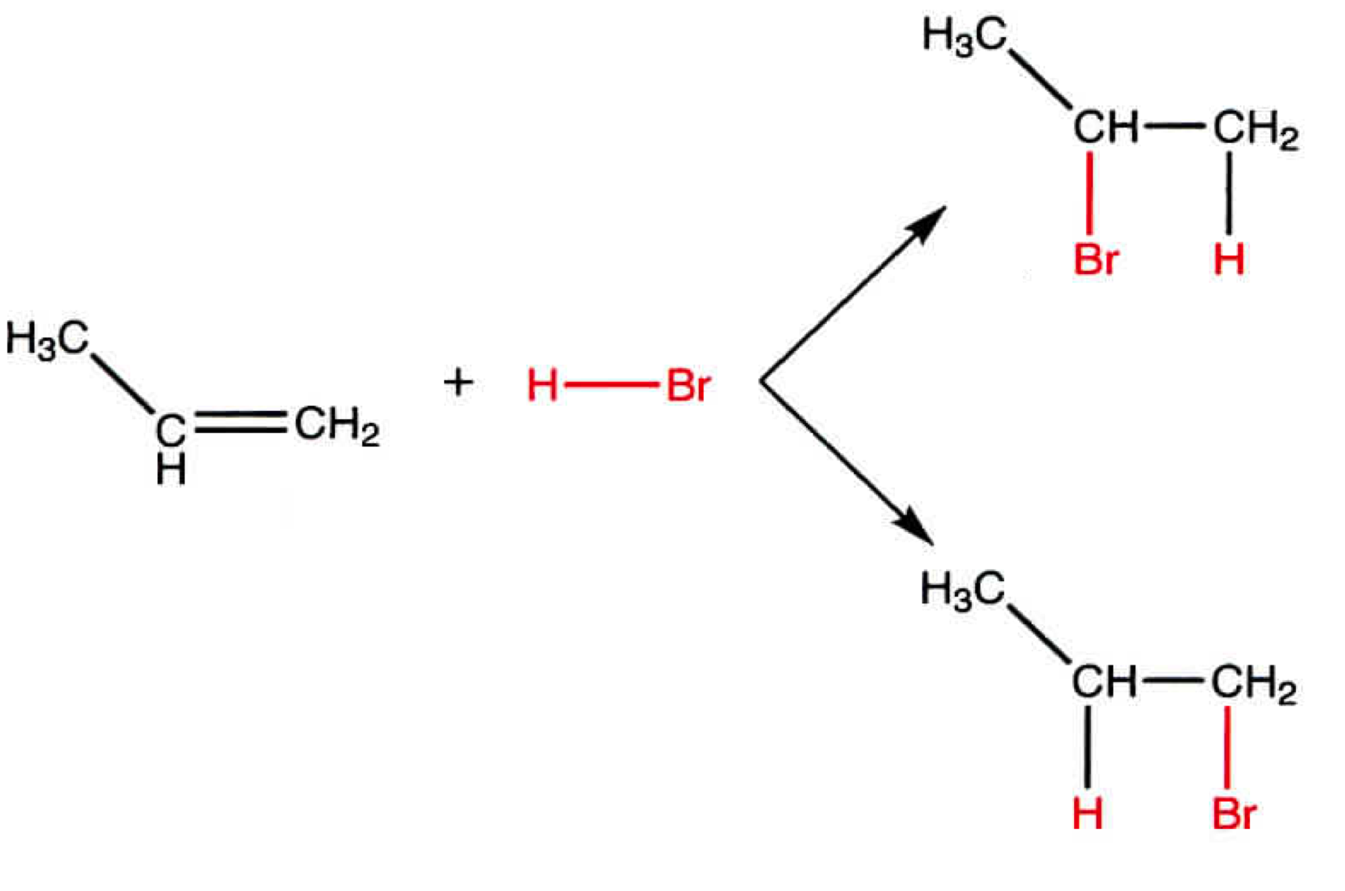
Which is the preferred product?

Slide 20
Which is the preferred product?

Slide 21
Electrophilic addition of halogens
(aka halogenation)

Slide 22
Electrophilic addition of hydrogen
(aka hydrogenation)

Slide 23
Electrophilic addition of interhalogens
(contains two different halogens)

Slide 24
Electrophilic substitution
reactions of benzene
Unlike alkenes, the benzene ring is quite hard to break and will not undergo addition.
Benzene will undergo substitution by losing hydrogens.

Slide 25
For example:
AlCl3

Slide 26
Electrophilic substitution:
Nitration of benzene
Overall reaction:

Slide 27
Step 1
The sulfuric acid protonates the nitric acid, which loses water to form the NO2⁺ electrophile

Slide 28
Step 2
Step 3

Slide 29
Reduction Reactions (HL)
For organic compounds, oxidation involves the adding
C-O bonds. Reduction involves the adding C-H bonds.

Slide 30
Reduction of Carbonyl Compounds
(aldehydes, ketones, & carboxylic acids)
Two common reducing agents:
Lithium aluminum hydride (LiAlH4)
and Sodium borohydride (NaBH4)
Both provide the needed hydride ion (H⁻), which acts as a nucleophile.

Slide 31
Reduction
LiAlH4
Oxidation
Cr2O7²⁻ / H⁺

Slide 32
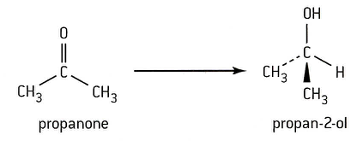
Reduction
LiAlH4
Oxidation
Cr2O7²⁻ / H⁺

Slide 33
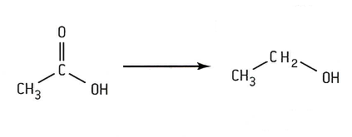
Reduction
LiAlH4
Oxidation
Cr2O7²⁻ / H⁺
ethanoic acid
ethanol
(reflux)

Slide 34
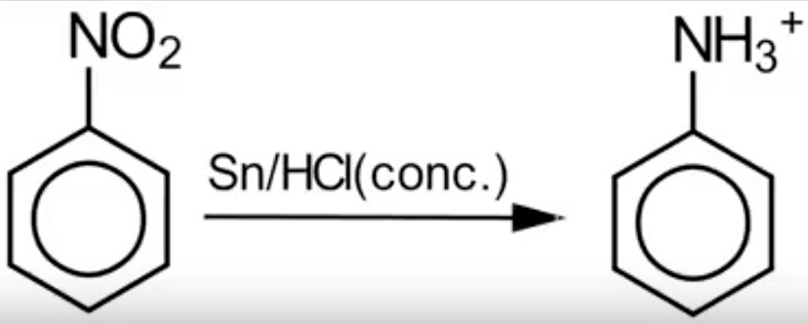
Reduction of nitrobenzene
Step 1
Heat / reflux
nitrobenzene
phenylammonium
ion

Slide 35
Step 2
phenylamine

