Slide 1
C.4 Solar energy
Photosynthesis:
An endothermic process in which green plants use light energy to produce stored chemical energy in the form of carbohydrates, such as glucose.

Slide 2
What allows photosynthesis to take place is the green pigment chlorophyll that contains a system of alternating single and double bonds.

Slide 3
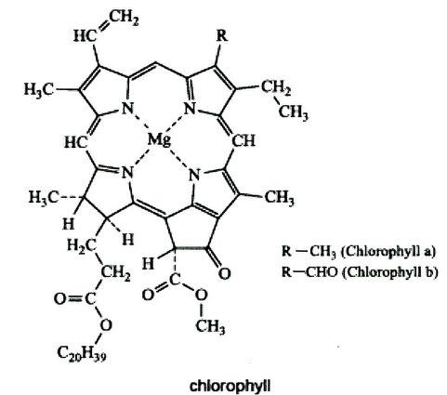

Slide 4
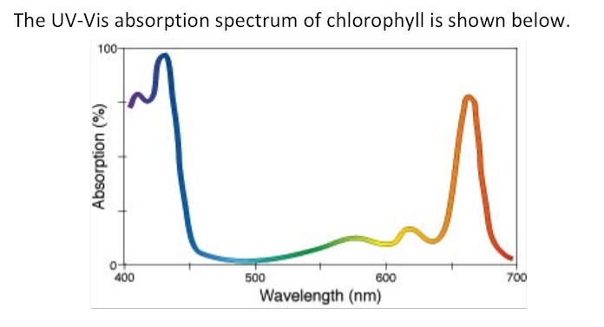
Why is chlorophyll green?
The resonance occurring within the molecule absorbs nearly all colors of visible light except green, which is reflected back.

Slide 5
It’s the resonance within conjugated structures that absorb light energy.
The green pigments of the chlorophyll molecule absorbs red and blue light, and reflects back green.
This is the energy that fuels the process of photosynthesis.

Slide 6
Practice:

Slide 7
Practice:

Slide 10
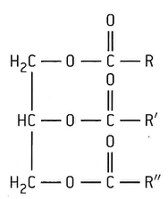
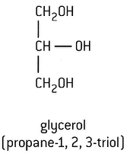

Slide 11
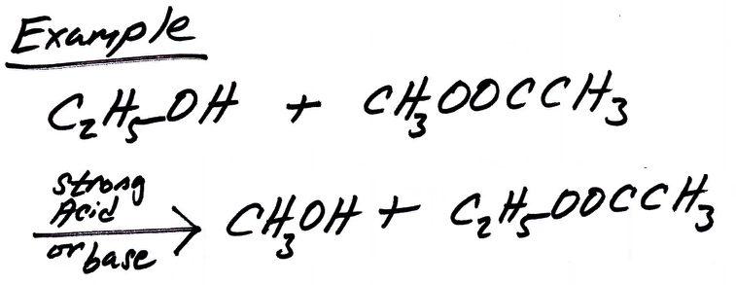

Slide 12
Practice:

Slide 13
Practice:

Slide 14
