Slide 1
15.2 Entropy and spontaneity

Slide 2
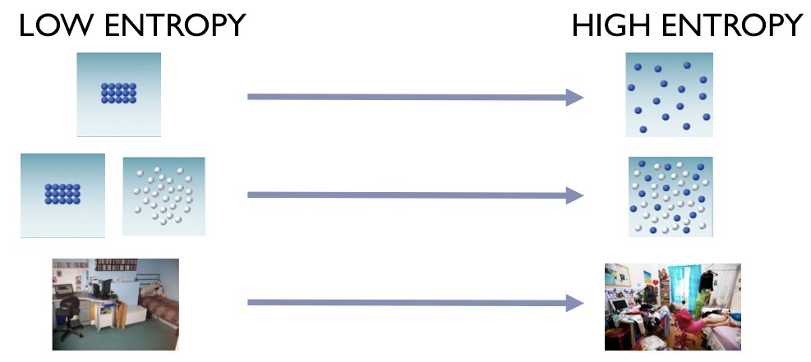
Entropy (S): A measure of randomness (disorder).

Slide 3
Key idea: Nature spontaneously proceeds towards those states that have the highest probabilities of existing.

Slide 4
Lower Entropy | Higher Entropy
Slow moving particles | Fast moving particles
Particles close together | Particles spread out
Fewer particles | More particles
Solids | Gases

Slide 5
For changes of state:
Ssolid < Sliquid < Sgas

Slide 6
Entropy will increase when:
Temperature increases
More particles (moles) form in a chemical reaction
These changes of state:
solid → liquid
liquid → gas
solid → gas

Slide 7
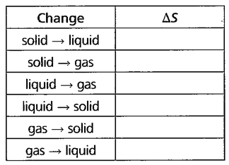
Predict the sign for entropy:

Slide 8
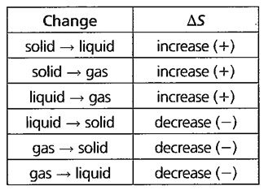
Predict the sign for entropy:

Slide 9
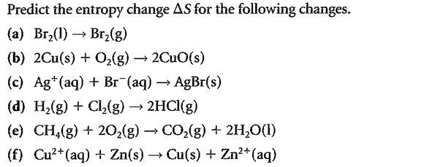

Slide 10
ΔS = +
ΔS = -
ΔS = -
ΔS = 0
ΔS = -
ΔS = 0

Slide 11
Calculating entropy:
ΔS° = ΣS°(products) - ΣS°(reactants)
(see handout: thermodynamic values)

Slide 12
Spontaneity:
A spontaneous process occurs naturally on its own.
(does not refer to the length of time for a process to occur)

Slide 13
The First Law of Thermodynamics:
In any chemical or physical process, energy is neither created nor destroyed.
The Second Law of Thermodynamics:
In any spontaneous process there is always an increase in the entropy of the universe.

Slide 14
The Third Law of Thermodynamics:
The entropy of a perfect crystal at absolute zero is exactly equal to zero.

Slide 15
If ∆Suniverse = positive (+),
the process is spontaneous.
If ∆Suniverse = negative (-),
the process does not take place
(spontaneous in the opposite direction).

Slide 16
∆Suniverse = ∆Ssystem + ∆Ssurroundings

Slide 17
∆Suniverse = ∆Ssystem + ∆Ssurroundings

Slide 18
Gibbs Free Energy
The sign of ∆Ssur depends on the direction of heat flow.
∆Ssur ∝ - ∆Hsystem
The magnitude of ∆Ssur depends on the temperature.
∆Ssur ∝ 1/T
(where T is in kelvins)

Slide 20
Therefore,
∆Ssur = -
∆Hsys
T

Slide 21
Substituting into,
∆Suni = ∆Ssys + ∆Ssur
becomes,
∆Hsys
∆Suni = ∆Ssys -
T
multiplying through by - T gives,
-T∆Suni = ∆Hsys - T∆Ssys

Slide 22
-T∆Suni = ∆Hsys - T∆Ssys
∆G
Called “Gibbs free energy”
∆G = ∆H - T∆S
Note: all values refer to the system

Slide 23
Gibbs free energy (trivia):
aka “available energy”
derived in the 1870s by the American mathematician Josiah Willard Gibbs

Slide 24
∆G = ∆H - T∆S
Recall,
-T∆Suni = ∆H - T∆S
Therefore,
∆G= -T∆Suni
From this we can conclude,
1. If ∆G is negative then ∆Suni is positive and the process is spontaneous.
2. If ∆G is positive then ∆Suni is negative and the process is not spontaneous.

Slide 25
Thermodynamics Summary: The Driving Forces
∆G = ∆H - T∆S
 | ∆H |  | ∆S |  | ∆G | Spontaneous?
1 | - |  | + |  | - | Always
2 | + |  | + |  | ? | Only at high temperatures
3 | - |  | - |  | ? | Only at low temperatures
4 | + |  | - |  | + | Never

