Slide 1
Steps for drawing
Lewis structures
for Molecular Compounds

Slide 2
Total the valence electrons from all atoms in the molecule (if an ion, add or subtract its charge).

Slide 3
2. Use dashes to connect all atoms to a "central" atom.

Slide 4
3. Add dots to the outer atoms to complete their octet (except H).

Slide 5
4. Add remaining electrons to complete the central atom’s octet...
If not enough electrons, use lone pairs on the outer atoms to form double (=) or triple (≡) bonds.
Note: Only carbon, nitrogen and oxygen are capable of forming triple bonds.

Slide 6
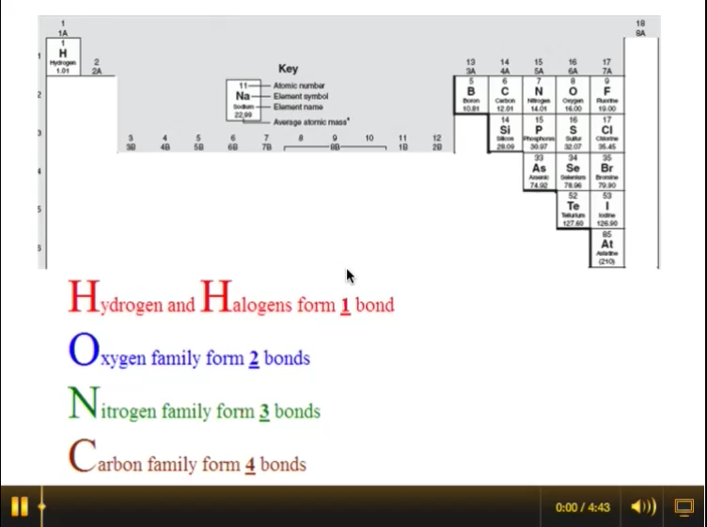
The HONC Rule

Slide 7
  Is your Lewis structure correct?
Two simple questions to ask:
1.) Did you use the exact number of valence electrons available?
2.) Are all atoms (except hydrogen) surrounded by 8 electrons?

Slide 8
Special note regarding carbon:
Carbon rarely has an unshared pair of electrons.
Two exceptions:
CO
carbon monoxide
CN⁻
cyanide

Slide 9
Exceptions to the octet rule:
1. Hydrogen will have only 1 pair of electrons surrounding it.
2. Boron will only have 3 pairs of electrons surrounding it.

Slide 10
3. Sulfur and Phosphorus will occasionally have more than 4 pairs of electrons by using their empty d-orbitals.
This is called an “expanded octet.”

Slide 11
Special note regarding oxyacids:
(H bonded to an oxyanion)
Hydrogen will ALWAYS be bonded to the oxygen atom(s).

