Slide 1
=Unit 5=
Chemical Equilibrium
(IB Text Ch 7)

Slide 2
7.1 Equilibrium

Slide 3
Chemical Equilibrium:
The state in which forward and reverse reactions occur at equal rates.
The state at which the concentrations of all reactants and products remain constant.

Slide 4
Example:
NaCl(s) —> Na⁺(aq) + Cl⁻(aq)
When the solution becomes saturated, the reaction will begin to reverse itself:
NaCl(s) ⇆ Na⁺(aq) + Cl⁻(aq)
Both forward and reverse reactions occur simultaneously and continuously.
(Called a “dynamic” process.)

Slide 5
When
forward rate = reverse rate,
a state of equilibrium
is said to have been reached.

Slide 6
Consider the following reaction:

Slide 7
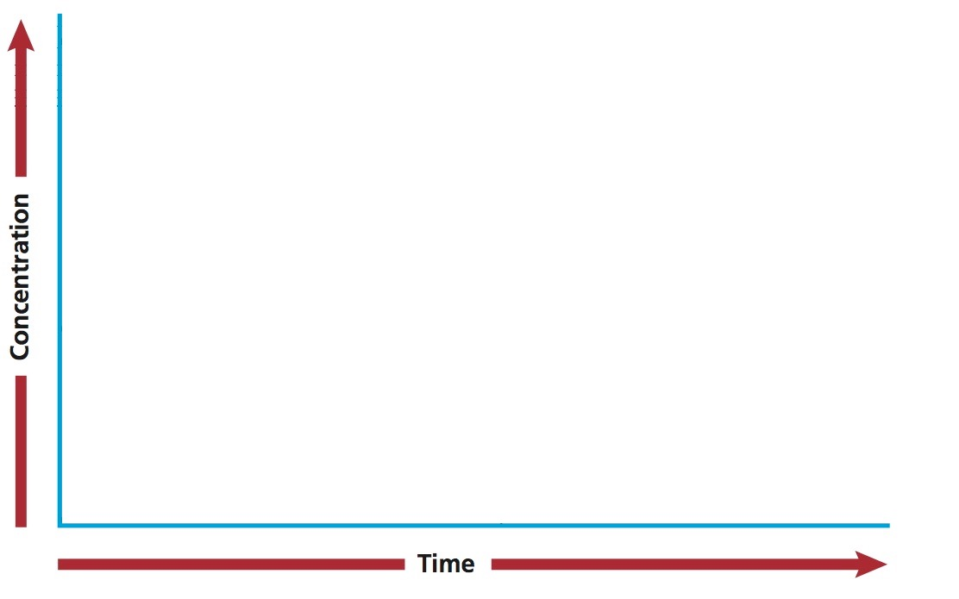

Slide 8
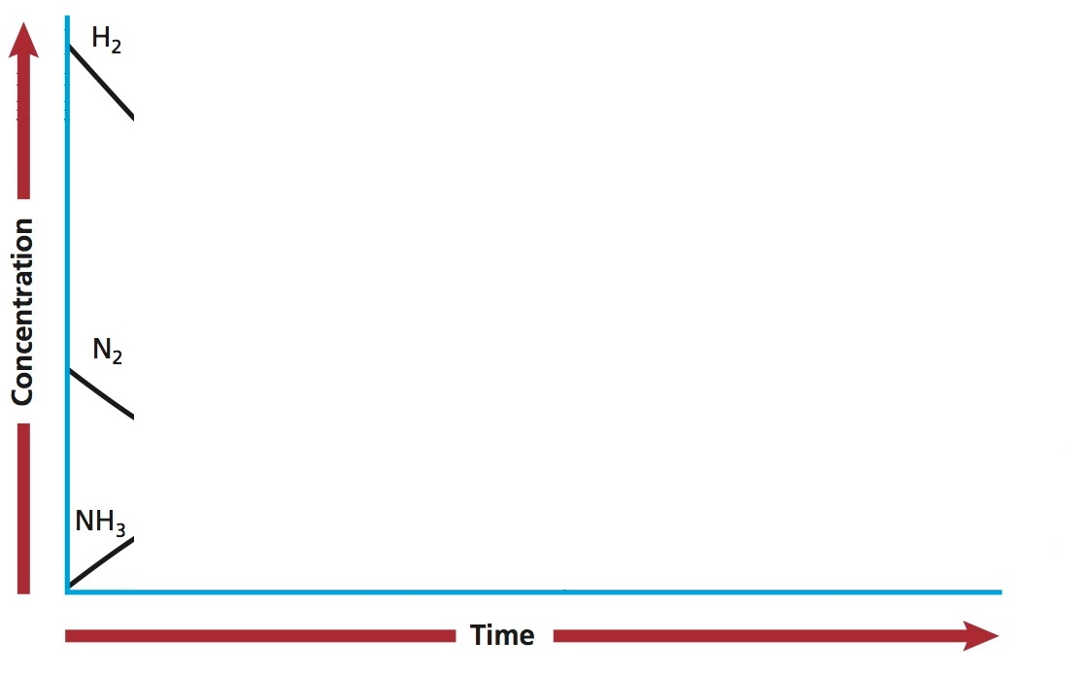

Slide 9
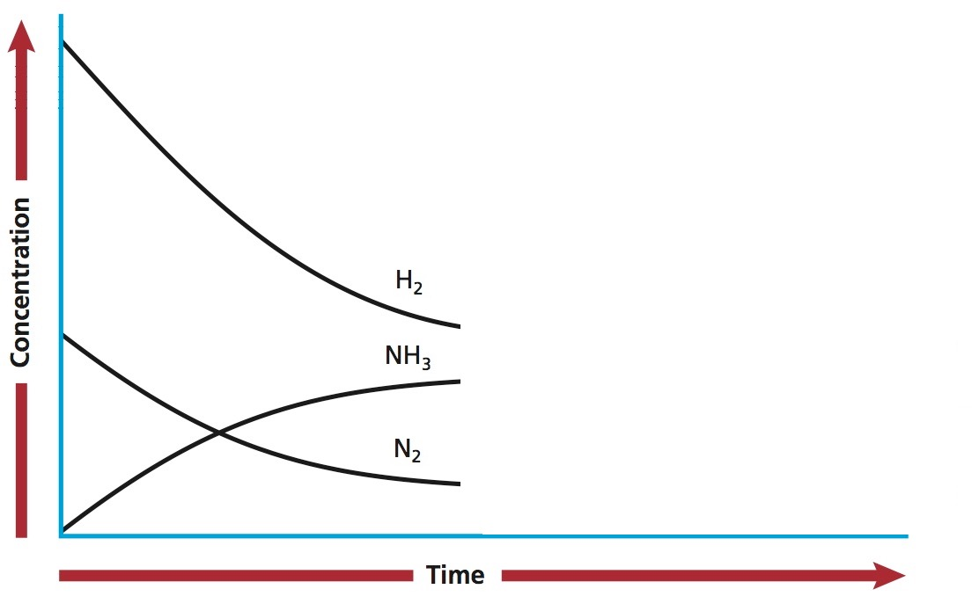

Slide 10
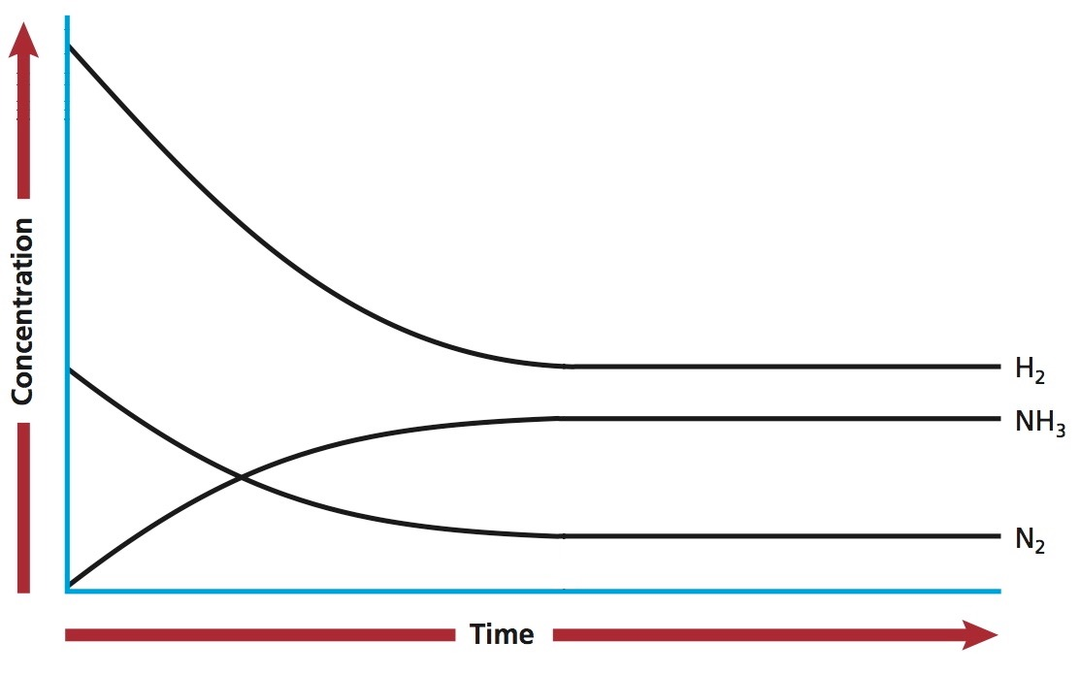

Slide 11
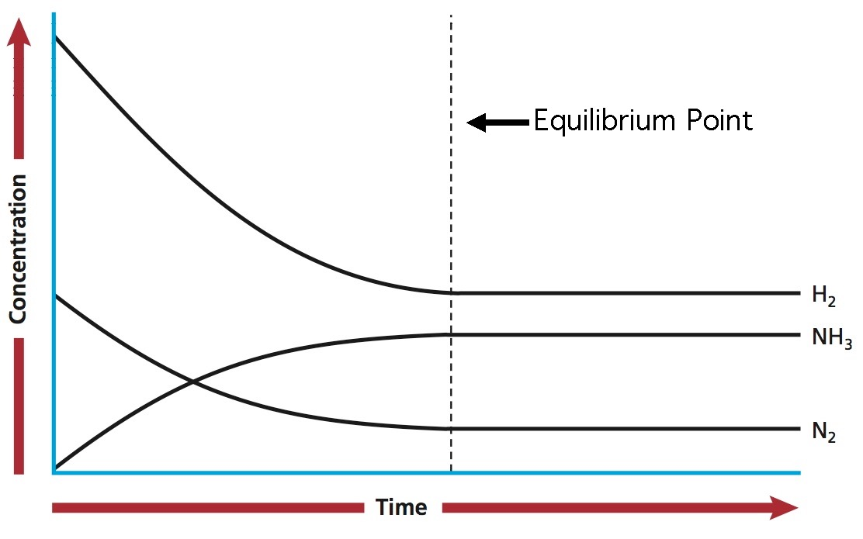

Slide 12
The Equilibrium Constant

Slide 13
The Law of Equilibrium
If at a given temperature,
aA + bB ⇋ cC + dD
Then,
[C]^{c}[D]^{d}
The value of Kc will be constant for any specified temperature.
Kc=
[A]ª[B]^{b}
The equilibrium constant

Slide 14
The value of Kc :
If Kc > 1,
rxn is product favored
If Kc < 1,
rxn is reactant favored
If Kc = 1,
neither reactant nor product favored

Slide 15
The magnitude of Kc :
If Kc >> 1,
rxn goes to completion
(of the order Kc > 1000)
If Kc << 1,
rxn does not take place
(of the order Kc < 0.001)

Slide 16
Phases and Kc
Kc is independent of solids and liquids, as their concentrations do not change.
Therefore, solids and liquids are not included in the equilibrium expression.

