Slide 1
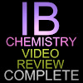
Unit 1: Stoichiometric Relationships

Slide 2
1.1 The particulate nature of matter and chemical change

Slide 3
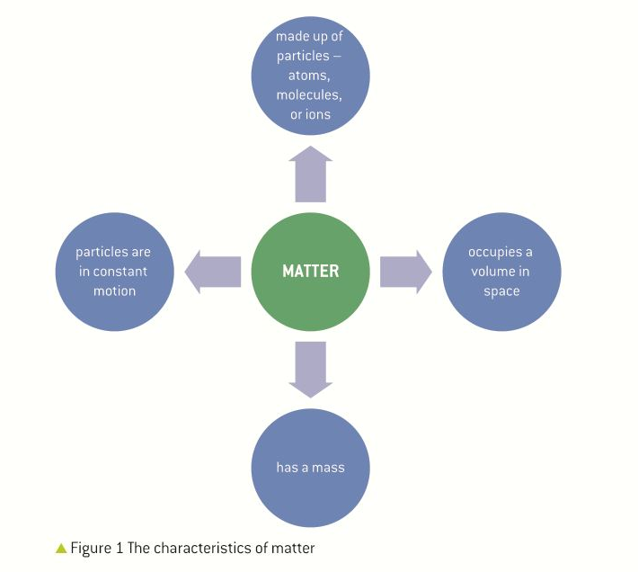
See page 2 of your text:

Slide 4
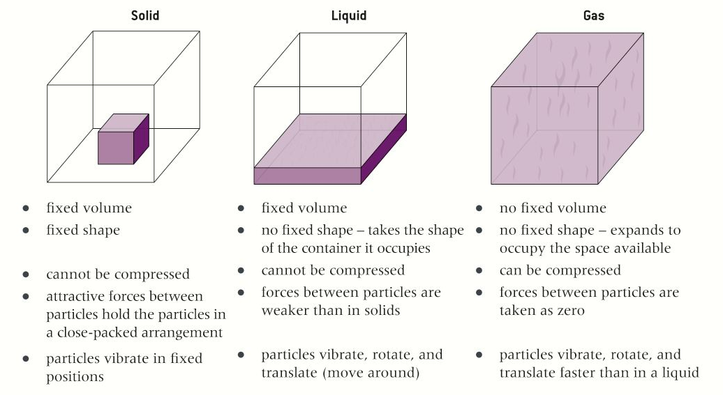
See page 3: States of Matter

Slide 5
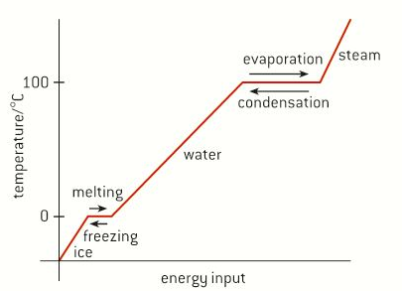
See page 3: Change of state

Slide 6
See page 3: Change of state
During any change in state, bonds are formed or broken.
Melting or boiling are processes where bonds are broken.
Freezing or condensation are processes where bonds are formed.
(i.e., endothermic)
(i.e., exothermic)

Slide 7
Temperature:
A measure of the average kinetic energy of the particles of a substance.
Movement of particles will depend on temperature (vibration, rotation, translation…).
SI unit: the kelvin (K).
Absolute zero: all movement stops
0 K = -273 ℃

Slide 8
Elements:
All substances are made up of one or more elements.
There are over 112 known elements, though only the first 92 occur naturally.
The smallest part of an element is called an atom.

Slide 9
Compounds:
Contain 2 or more different elements chemically bonded in a fixed ratio.
Can only be broken down chemically.
Have different chemical properties from their component elements.

Slide 10
Consider NaCl:

Slide 11
Mixtures:
Contain different elements and/or compounds that are not chemically combined.
Components can be separated by physical means, such as:
Filtration
Crystallization
Solubility
Chromatography

Slide 12
Paper Chromatography:

Slide 13
Mixtures can be
Homogeneous: uniform composition.
Heterogenous: non-uniform composition.

Slide 14
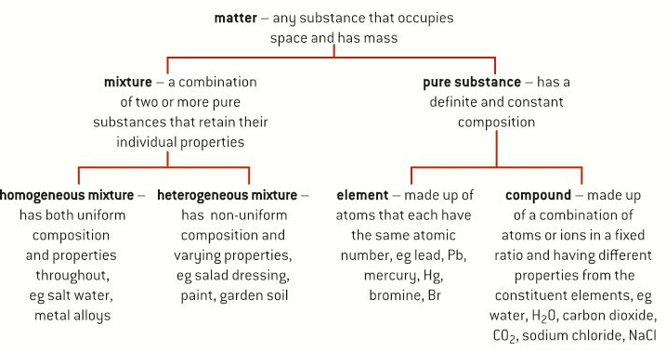
See page 6 of your text:
In your notes, copy this flow chart using just the main categories (i.e., bold print)

Slide 15
Ionic equations (aka net ionic eq.)
only show those ions involved in the formation of new compounds.
Example:
Mg(s) + 2HCl(aq) —> H2(g) + MgCl2(aq)
Ionic eq:
Mg(s) + 2H⁺(aq) —> H2(g) + Mg²⁺(aq)

Slide 16
Page 11
Atom economy:
The amount of starting materials that become useful products.
(related to “green chemistry”)

