Slide 1
Pi (π) and sigma (σ) bonds

Slide 2
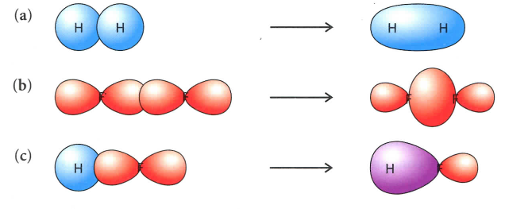
Sigma (σ) bonds resulting from the axial overlap of orbitals:
An end-to-end overlapping
of s, p, or hybrid orbitals.

Slide 4
Pi (π) bonds result from the sideways overlap of parallel p orbitals:
A sideways overlapping of p orbitals
above and below a sigma bond.

Slide 6
