Slide 1
4.3 Covalent Structures

Slide 2
Bond length and strength
 | Bond length | Bond strength
single bonds | longest | weakest
double bonds | intermediate | intermediate
triple bonds | shortest | strongest

Slide 4
Resonance Structures:
A molecule or polyatomic ion that cannot be represented by a single Lewis structure.
(All will contain a double bond that can be placed on more than one atom)

Slide 5
Dative (coordinate) covalent bond:
When one atom supplies both electrons in a covalent bond.

Slide 6
Pages 117-120
Large covalent structures: carbon, silicon, and silicon dioxide.

Slide 7
Carbon can exist as 3 separate
allotropes*:
*Two or more different physical forms in which an element can exist.

Slide 8
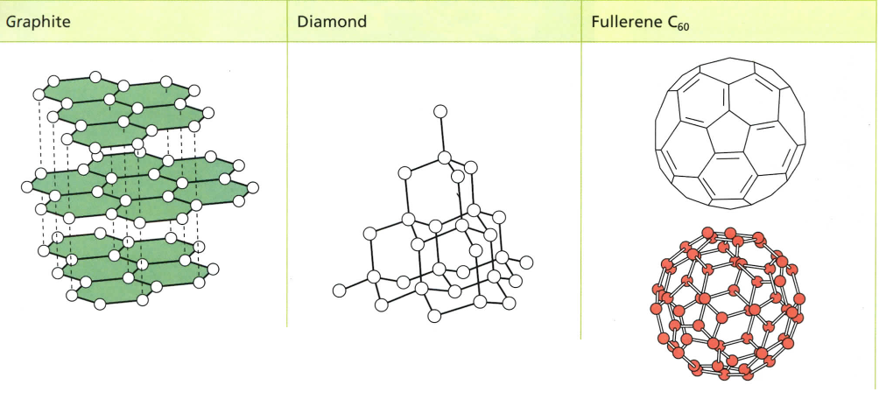

Slide 9
Carbon can exist as 3 separate
allotropes:
-Graphite: planer, each atom is covalently bonded to 3 others (has resonance).
-Diamond, each atom is covalently bonded to 4 others.
-Fullerene, each atom is covalently bonded within a sphere of 60 atoms.

Slide 10
Summary:
 | Graphite | Diamonds | Fullerene
Bonding: | trigonal planar | tetrahedral | 60-atom sphere
Structure: | parallel layers that slide over one another (held together only by weak dispersion forces) | large network solid (hardest known natural substance) | closed sphere with each carbon atom bonded to three others.
Resonance | Yes | No | Yes
Electrical conductivity: | Yes | No | Yes
Uses: | pencils; lubricant | jewelry; cutting tools | superconducting material; nanotubes

Slide 11
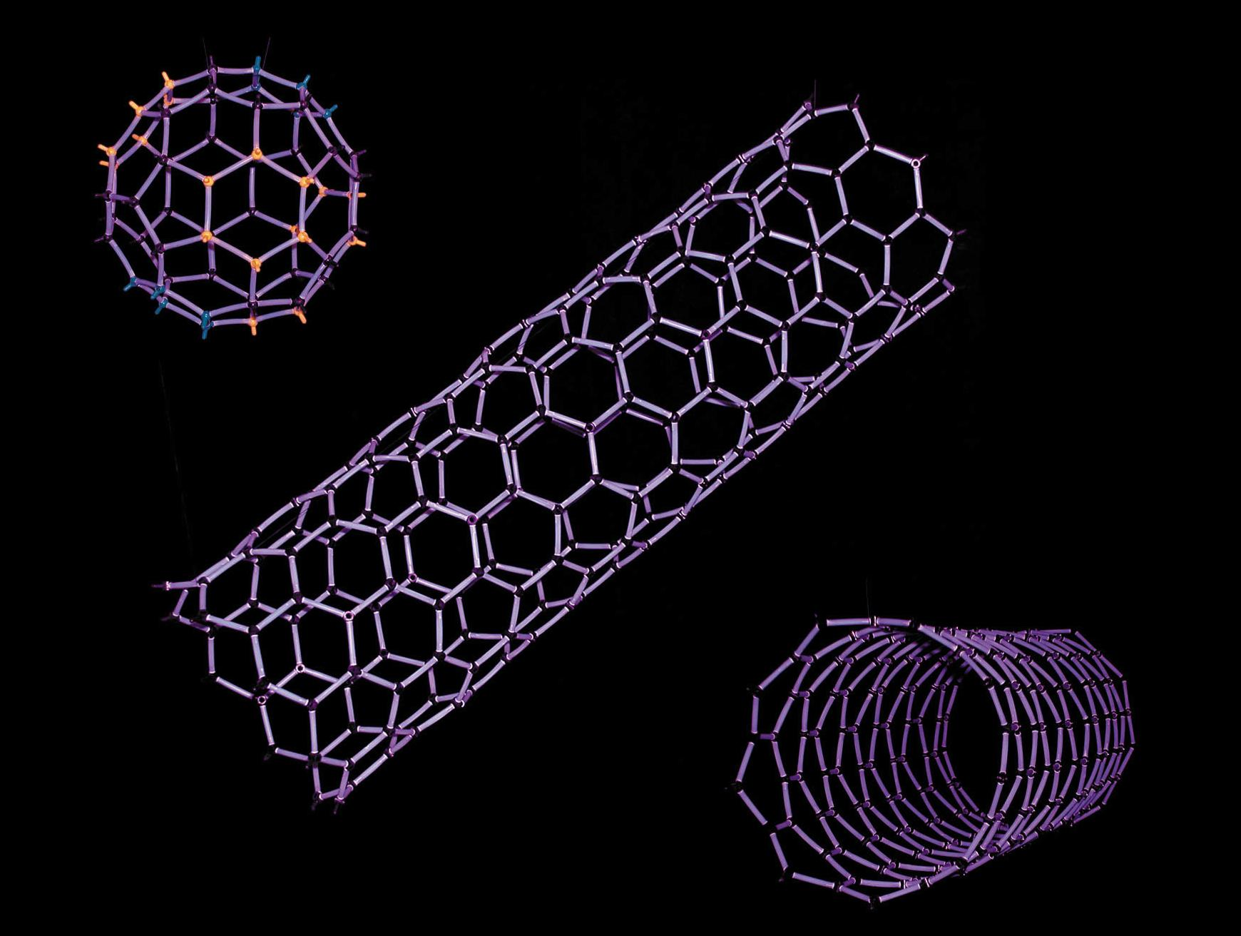
Nanotubes:

Slide 12
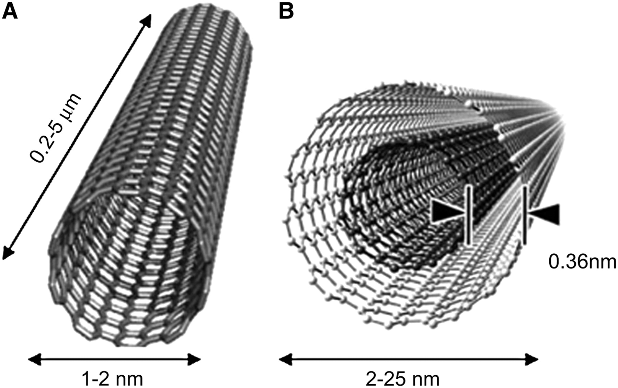
Nanotubes:

Slide 13
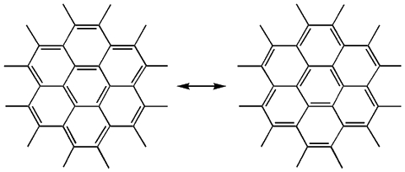
Due to the resonance of the benzene rings, graphite is easily able to conduct electricity.
e⁻
e⁻
graphite

Slide 14
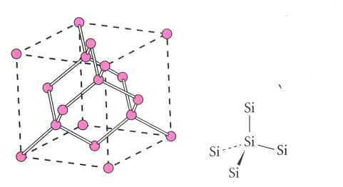
Silicon:
-Tetrahedral bonding, similar to a diamond although its bonds are much weaker.
- Results in a giant covalent lattice.
(aka: macromolecule or a network solid)

Slide 15
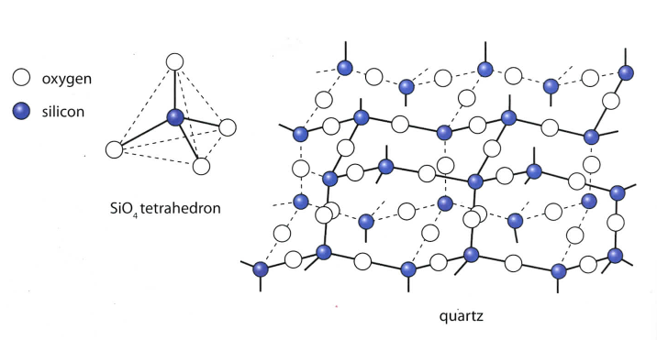
Silicon dioxide (quartz):
-Tetrahedral bonding, with each silicon atom bonded to four oxygen atoms and each oxygen atom bonded to two silicon atoms.
- Forms a giant covalent network solid.

Slide 16
Dimerization:
When two identical molecules combine in order to form more stable octets.
Example: NO2 will become N2O4

Slide 17
The VSEPR model
(valence shell electron pair repulsion)
Use to predict molecular:
shape
bond angles
polarity

Slide 18
To determine molecular shape, count the total number of “electron domains.”
An electron domain is any pairing of electrons:
single bonds ( - )
triple bonds ( )
double bonds ( = )
:
lone pairs ( )
repel most of all!!!

Slide 19
All electron domains will arrange around a central atom as far apart as possible.
(see summary handout)

Slide 20
Molecular Polarity
Nonpolar molecules are symmetrical with all bond polarities canceling each other.

Slide 21
Polar molecules are asymmetrical (non symmetrical) and will have the overall (net) bond dipoles directed towards one side of the molecule.
A molecule will always be polar if the central atom:
has a lone pair
is bonded to different atoms

