Slide 1
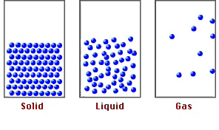
Unit 3, part 2: Gas Stoichiometry

Slide 2
Gas: The state of matter where all particles move independently, with vast distances between them.
Gases will
expand to fill their container

Slide 3
The Gas Variables:
Volume (V)
Size of the container holding the gas (Units: L, mL, dm³, cm³)
Temperature (T)
Proportional to the KE of the gas particles (Unit: K)
Pressure (P)
Collective force exerted by the gas particles (Units: atm, mm Hg, torr, kPa)
moles (n)
Moles of gas particles (Unit: mol)

