Slide 1
Unit 2 Bonding
(Topic 4: Bonding)

Slide 2
4.1 Ionic bonding

Slide 3
An ionic bond is an electrostatic attraction between oppositely charged ions.
General rule:
A compound is ionic if it contains a metal.

Slide 4
Ions form as a result of electron transfer:

Slide 5
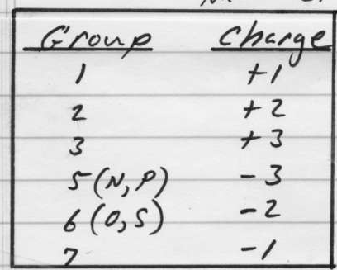
Common monatomic ions:

Slide 6
By definition, transition metals can form more than one ion. Such as:
Fe²⁺
Fe³⁺
Cu⁺
Cu²⁺
Cr²⁺
Cr³⁺

Slide 7
Polyatomic ions you need to know:
NO3⁻
nitrate
NH4⁺
ammonium
SO4²⁻
sulfate
HCO3⁻
bicarbonate
(hydrogen carbonate)
CO3²⁻
carbonate
CH3COO⁻ acetate (or C2H3O2⁻)

Slide 8
Crystal Lattice

Slide 9
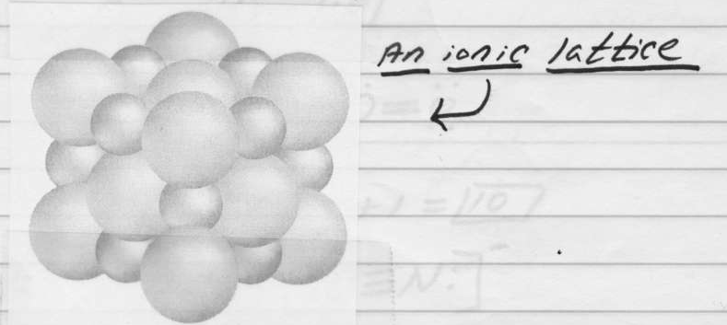
Ionic lattice: A three-dimensional structure composed of regularly repeating positive and negative ions.

Slide 10
Properties of Ionic Compounds:
High melting & boiling points
An electrolyte (conducts electricity when molten or dissolved in water)
Hard & brittle

Slide 14
The strength of ionic bonds are:
Directly proportional to the charge of the ions.
Inversely proportional to the size of the ions.
Note: the stronger the bonds, the higher the melting point.

Slide 15
For each of the following pairs of ionic compounds, circle which would have the highest melting point:
a. LiF or KBr
b. CaBr2 or CuF2
c. K2O or Fe2O3

