Slide 1
9.2 Electrochemical cells
Electrochemistry:
The Study of the interchange of chemical and electrical energy during a redox reaction.

Slide 2
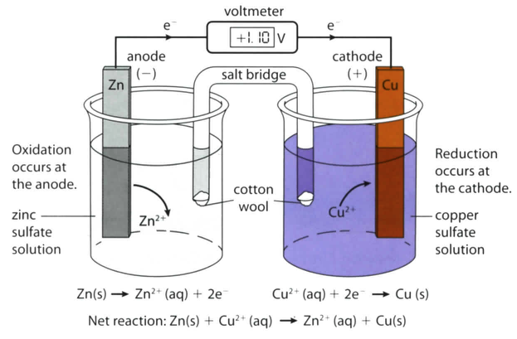
Voltaic Cells
(aka: Galvanic or Electrochemical cells)

Slide 3
Voltaic Cells
(aka: Galvanic or Electrochemical cells)
Spontaneously converts chemical energy into electrical energy.
Named for Alessandro Volta, an Italian physicist credited with its invention in 1800.

Slide 5
Cell notation: Zn(s)/Zn²⁺(aq) || Cu²⁺(aq)/Cu(s)

Slide 6
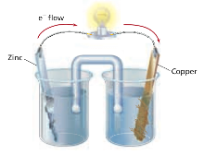
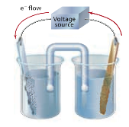
Electrolysis:
The use of electrical energy to bring about a chemical change.
Voltaic Cell
Electrolytic Cell
Chemical change -->
Electrical energy
Electrical energy --> Chemical change

Slide 7
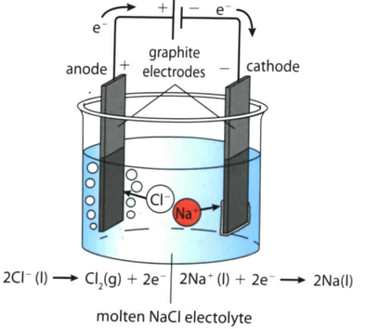
Electrolytic Cells

Slide 8
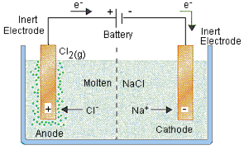
Electrolysis of Molten Sodium Chloride, NaCl(l)
Text

Slide 9
Electrolysis can be used to obtain reactive metals from common ores,
such as those that contain Na or Al.
Example:
Bauxite is main source of aluminum, which consists mostly of the mineral gibbsite, Al(OH)3

Slide 10
Summary

